Slide 1
Class 9
Policies and Institutions: National, United States by
Alan V. Deardorff
University of Michigan
2022
PubPol/Econ 541

Slide 2
Announcements
Quiz: Today’s quiz does not ask for you to upload any file.
Would any of you prefer to have quizzes available starting on Tuesdays? (But still due Friday night)
  That won’t work for quizzes 11 and 12, which cover material from those Thursdays

Slide 3
Announcements
More on Papers
  Linear supply and demand are fine
  Results in table, with just discussion in text and conclusion
  Agriculture, alternative crops: just say a little
  Ratio of output to employment: use data on production and employment
  Always: be careful and explicit of units of measurement

Slide 4
Pause for Discussion

Slide 5
  Questions on Jackson, Ch 3
Should (according to Jackson), and do, international institutions like the WTO interfere with the sovereignty of its member states?

Slide 6
Outline
Parts of the US Government that Handle Trade
Main Features of US Trade Policies
  Tariffs, Quotas, VERs
  Escape Clause
  Unfair Trade Laws
  Section 301
  Section 332
  Trade Adjustment Assistance
  Fast Track
  GSP
US Trade Policy under Trump and Biden

Slide 7

US Trade Institutions
US does NOT have a “ministry” or “department” of international trade
Most other countries do; e.g. …
  Canada: Department of International Trade
  Japan: Ministry of Economy, Trade and Industry (METI) (Used to be MITI)
  EU: Directorate General Trade
    Trade Commissioner:
    Valdis Dombrovskis
    since Aug 26, 2020

Slide 8
US Trade Institutions
In US, responsibility for trade issues is spread over many entities
  Congress
  USTR
  Commerce Department (& ITA within it)
  US International Trade Commission (USITC)
  Export-Import Bank
  and several others
Obama said several years ago that he sought to consolidate many of these in a single agency
  He never did

Slide 9
US Trade Institutions
USTR = United States Trade Representative
  Handles negotiations on trade issues with
    Other governments
    WTO
  Drafts trade legislation for Congress
  Does NOT set or implement trade policies

Slide 10
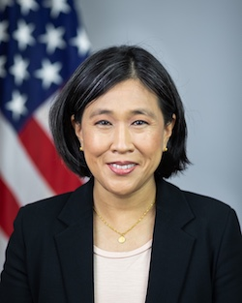
US Trade Institutions
Biden’s USTR is
Katherine Tai
Cabinet-level official of US government

Slide 11
US Trade Institutions
Congress
  Sets tariffs and other trade policies (thus approves trade agreements)
  Two committees are responsible
    House: Ways and Means
    Senate: Finance
  Why these?
    Because trade policy was originally about collecting revenue

Slide 12
US Trade Institutions
Administrative Agencies
  ITA = International Trade Administration
    Part of Department of Commerce
    Main Function: Determines “fairness” in unfair trade cases
      Are imports “dumped”?
      Are they “subsidized”?
    Orientation of ITA: very much favors US businesses

Slide 13
US Trade Institutions
Administrative Agencies
  ITC = USITC = United States International Trade Commission
    Independent agency
      Commissioners (6) are nominated by President and confirmed by Senate
      After that they are on their own
    Main Function: To determine “injury” in cases of
      Anti-Dumping
      Countervailing duties (subsidies)
      Safeguards (a.k.a., Escape Clause)

Slide 14
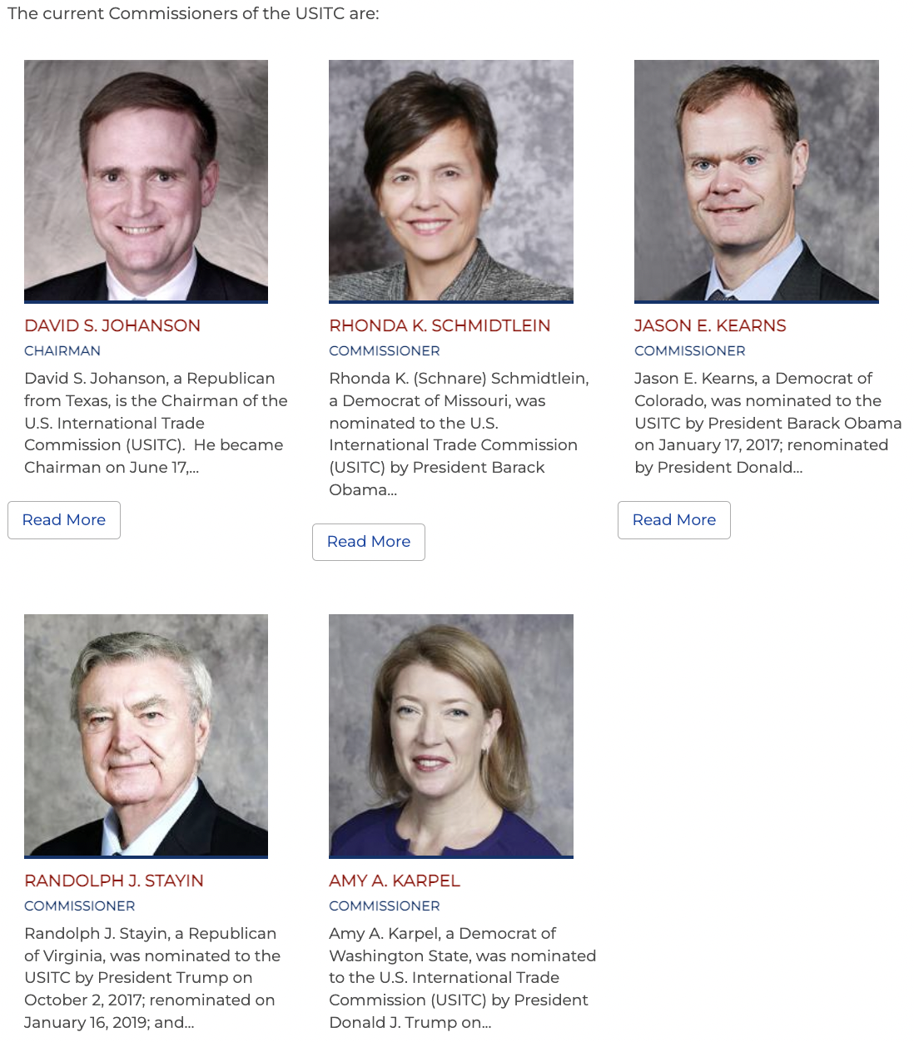
USITC Commissioners
Commissioners
  Serve 9-yr terms
  No more than 3 of one party
  Chair and vice chair from different parties
Staff ~365

Slide 15
US Trade Institutions
Export-Import Bank
  Official export credit agency of the US
  Assists foreign purchasers of US exports
    With loans
    Loan guarantees
    Etc.
  Was target of Tea Party in 2015 as “crony capitalism”
    Was prevented July, 2015 to May 2019, from funding projects of over $10 million

Slide 16
Pause for Discussion

Slide 17
  Questions on Jackson, Ch 3
To what part of the US government does the US constitution assign responsibility for commercial policy?
  What does this imply for the procedures by which the US enters into trade agreements?
Can the US federal government enter into international agreements that constrain the US states?
  Does the same apply to other negotiating units’ (e.g., Canada, the EU) abilities to commit their sub-units?
What units of the US government have responsibilities for aspects of US trade policies?

Slide 18
Features of US Trade Policies
Tariffs
  Column 2: Tariffs left over from pre-1934
    They apply only to N. Korea and Cuba
    But maybe now Russia
  Column 1: Tariffs applied to almost all countries
    MFN rates for WTO members and others
    Negotiated mostly zero rates for FTA members

Slide 19
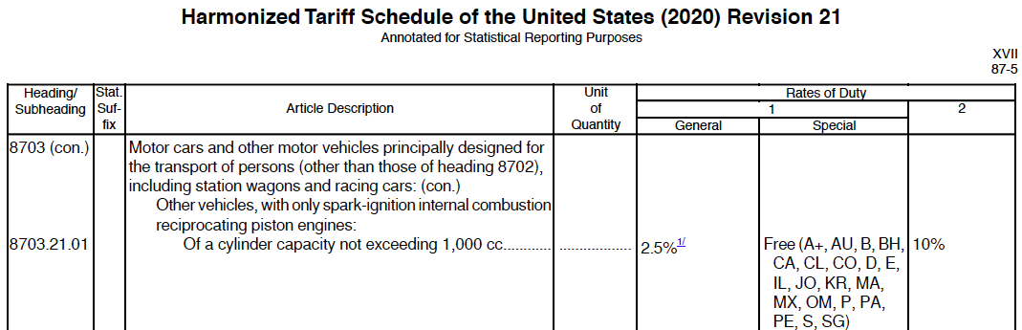

Slide 20
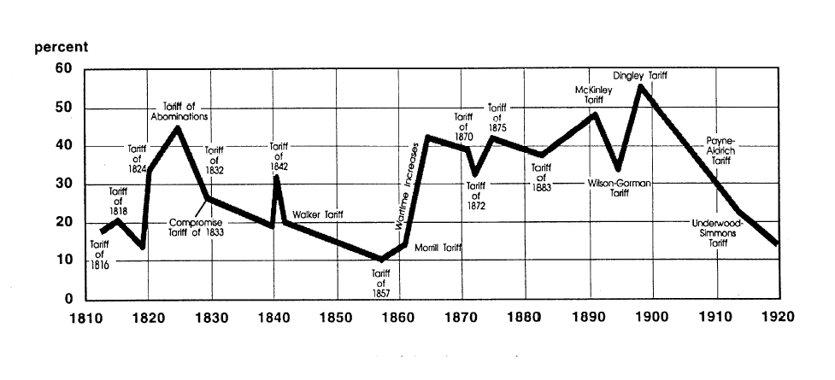
US tariff history: 1810-1920
Today
Notes:
Source: Don’t know

Slide 21
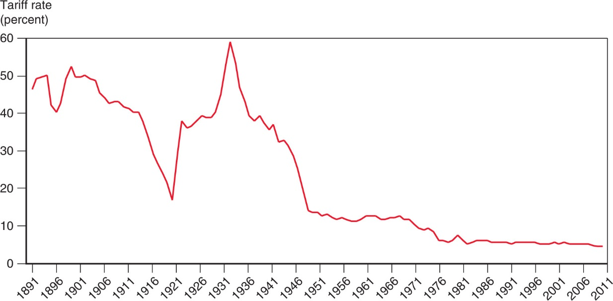
Figure 10.5 The U.S. Tariff Rate
Smoot-Hawley Tariff
1934 Reciprocal Trade Agreements Act
1947 GATT
1995 WTO
After rising sharply at the beginning of the 1930s, the average tariff rate of the United States has steadily declined.

Slide 22
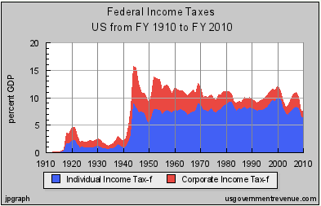
Features of US Trade Policies
Why the decline in tariffs? Partly due to revenues from income tax:
Notes:
Source: Irwin, Doug, “Trade Restrictiveness and Deadweight Losses from U.S. Tariffs,” 22 December 2008, Figure 1.

Slide 23
Features of US Trade Policies
Tariffs, quotas, etc.
  We still have high tariffs on a few products
    Textiles, apparel
      Men’s cotton shirts: 19.7%
      Women’s blouses: 26.9%
    Agriculture
Product | AVG % | MAX %
Dairy | 17.6 | 118
Coffee, tea | 3.2 | 54
Sugars | 13.3 | 66
Bev & Tobac | 15.0 | 350
Notes:
https://www.wto.org/english/res_e/statis_e/daily_update_e/tariff_profiles/US_e.pdf

Slide 24
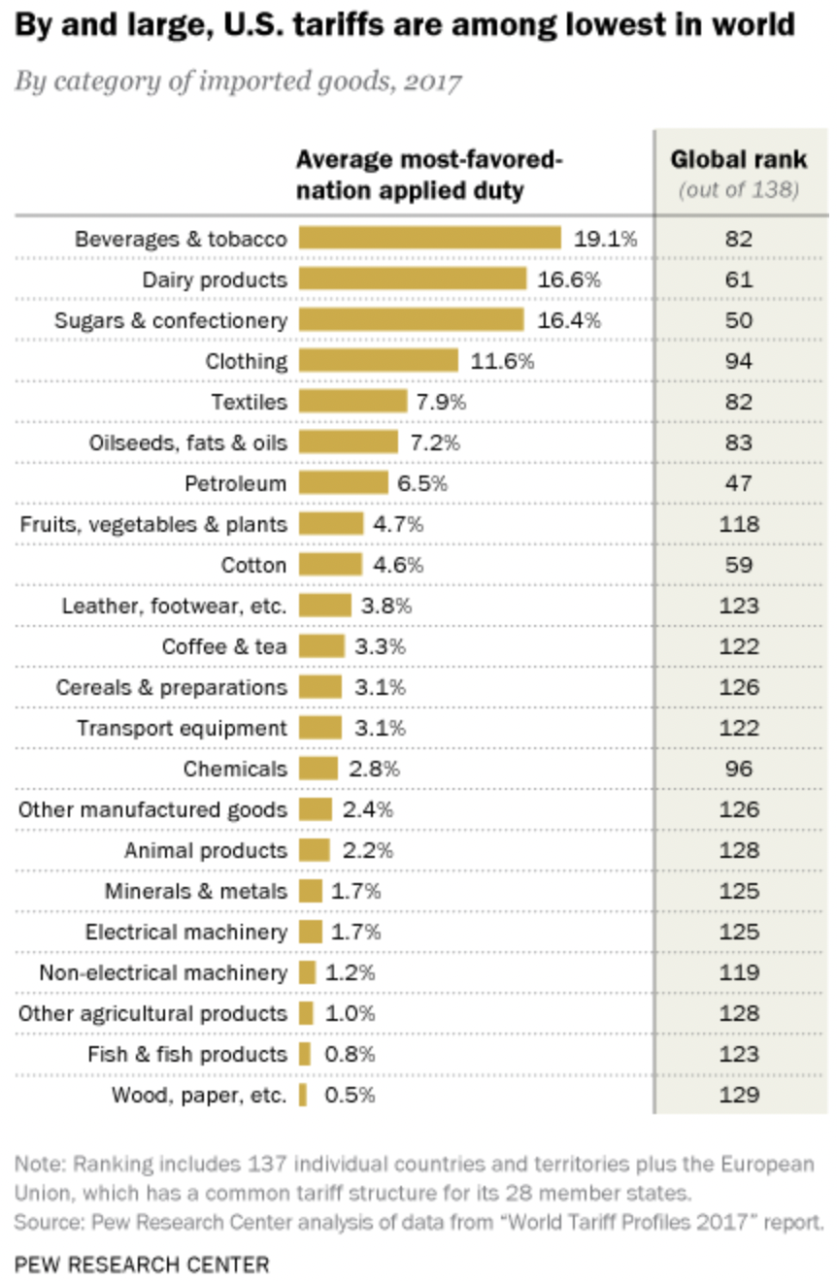
Source: Pew Research Center, 2018
Notes:
Desilver, Drew, “U.S. tariffs vary a lot, but the highest duties tend to be on imported clothing,” Pew Research Center, March 28, 2018.
https://www.pewresearch.org/fact-tank/2018/03/28/u-s-tariffs-vary-a-lot-but-the-highest-duties-tend-to-be-on-imported-clothing/

Slide 25
Features of US Trade Policies
De Minimus
  As we saw earlier, US levies tariffs on imports only if they are worth more than $800
  This is allowing increasing amounts of US imports to enter tariff-free
  See Zumbrun

Slide 26
Pause for Discussion

Slide 27
  Questions on Zumbrun
  “The $67 billion tariff dodge”
By how much have US de minimis imports risen?
What forces have caused this?
What is the role of “bonded trucks” and “bonded warehouses” in this?
Why do we now have uncertain data on the value of de minimis imports and the nature of the goods imported?
Does it seem likely that the US Congress will change this?

Slide 28
Features of US Trade Policies
Tariffs, quotas, etc.
  Quotas are still common in agriculture
  VERs: Voluntary Export Restraints
    No longer
    But Trump has negotiated something like VERs
  With Trump we have more high tariffs, and Biden has not removed them

Slide 29
Features of US Trade Policies
Escape Clause = Section 201
  Called “Safeguards” in WTO
  Permits temporary protection from injurious imports
    Does NOT allege that the imports are “unfair”
  Eligibility is decided by USITC alone
    Injury (must be “serious”)
    Causation (must be due to imports)
  Implemented by President, who may say NO.
  This was used under Trump for solar panels and washing machines (he could have said no)
  We’ll study it more on Nov 17

Slide 30
Features of US Trade Policies
Unfair Trade Laws
  Permit protection (not necessarily temporary) from “unfair” imports
    Must also be injurious, but less so than for escape clause (only “material injury”)
    “Unfair” if
      Subsidized by foreign government
      “Dumped”, i.e., priced too low by firm (more on this below)

Slide 31
Features of US Trade Policies
Unfair Trade Laws
  Fairness decided by ITA
  Injury decided by USITC
  President is NOT permitted to say NO
We’ll study these more Nov 29, Dec 1

Slide 32
Features of US Trade Policies
Section 301 of the Trade Act of 1974
  US law permitting tariffs on countries that engage in “unfair trade” (other than dumping and subsidies)
  What is unfair trade? “acts that are ‘unjustifiable’ or ‘unreasonable’ and burden U.S. commerce.”
  Before 1995,
    used extensively by US to pressure other countries, esp. Japan;
    after that, not until Trump
  2018 applied to China by USTR:
    “practices related to technology transfer, intellectual property, and innovation are unreasonable or discriminatory, and burden or restrict U.S. commerce.”
Notes:
Andres B. Schwarzenberg, “Section 301 of the Trade Act of 1974,” Congressional Research Service, Updated Aug 31, 2020.
https://crsreports.congress.gov/product/pdf/IF/IF11346#:~:text=Overview%20of%20Section%20301&text=U.S.%20commerce.,their%20markets%20to%20U.S.%20exports.

Slide 33
Features of US Trade Policies
Section 232 Tariffs: National Defense
  Used by Trump on Steel and Aluminum
  Has basis in US law, but WTO legality still questioned (see Fefer et al.)
  Biden administration insists WTO cannot question this

Slide 34
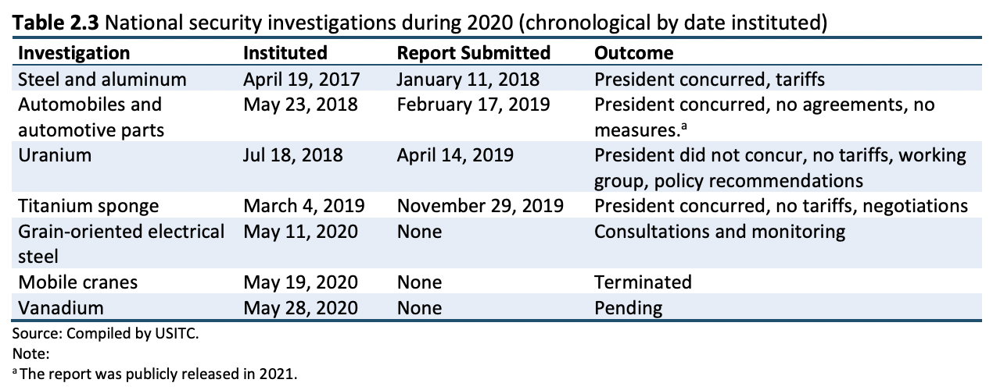
Source: USITC “The Year in Trade 2020”
Notes:
Jones, Lin, et al., “The Year in Trade 2020,” USITC, September 2021.
https://www.usitc.gov/publications/332/pub5228.pdf

Slide 35
Pause for Discussion

Slide 36
  Questions on Fefer et al.,
  “Section 232”
Under what circumstances does Section 232 of the 1962 Trade Act permit the President to levy tariffs?
Who conducts the investigation to determine if this is the case? If the answer is yes, must the President levy tariffs?
Must the tariffs apply to all imports of the product? If not, do we know why not?
Is the use of Section 232 legal under the rules of the WTO?

Slide 37
Features of US Trade Policies
Trade Adjustment Assistance (TAA)
  Provides temporary help (not tariff protection) for firms and workers hurt by imports
  Gives workers access to income support, relocation allowances, job search allowances, health coverage tax credit, and occupational training
  As of 2002, Alternative Trade Adjustment Assistance (ATAA) also provides limited “wage insurance” for trade-displaced older workers
  We’ll study more Nov 22

Slide 38
Features of US Trade Policies
Fast Track -- officially “Trade Promotion Authority” (TPA)
  Procedure, imposed by Congress on itself, requiring it to
  Relevant for approval of FTAs and some other trade deals
  Congress approved TPA in July 2015 but it expired July 1, 2021.
  Biden wants to “rethink the objectives of trade agreements before seeking the authority.”
Consider trade legislation without amendment

Slide 39
Features of US Trade Policies
Tariff Preference Programs
  GSP = Generalized System of Preferences
    Charge lower tariffs on some exports from some developing countries than we charge other countries
      Departure from MFN, permitted by WTO
    Other developed countries do this too
  AGOA = African Growth and Opportunity Act
    Zero tariffs on many goods from many sub-Saharan African countries
  CBI = Caribbean Basin Initiative
    Tariff preferences for most Caribbean countries
  NTPP = Nepal Trade Preference Program

Slide 40
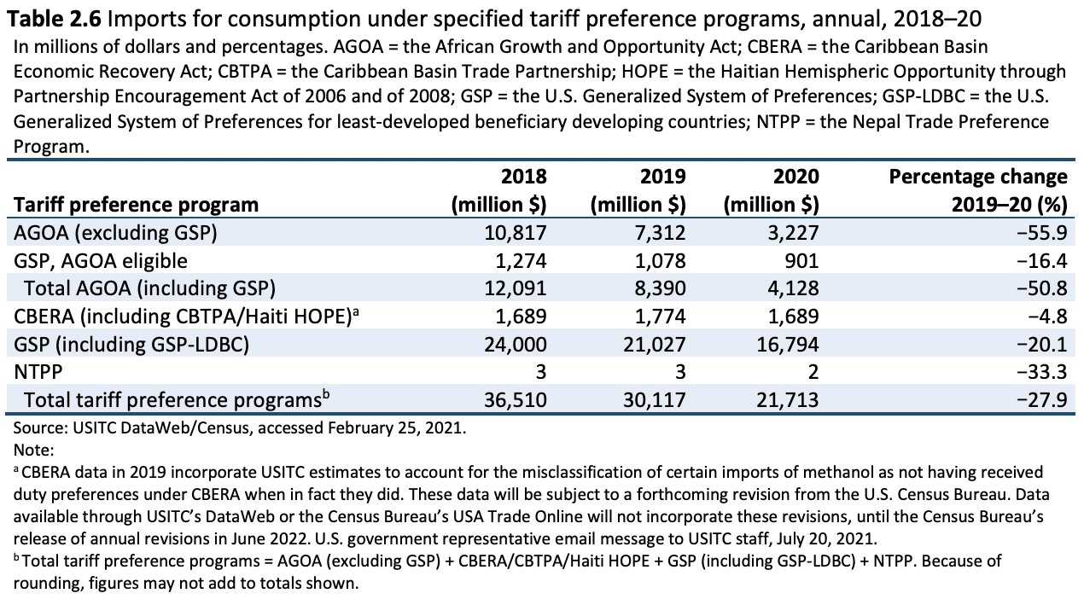
Source: USITC “The Year in Trade 2020”
Notes:
Jones, Lin, et al., “The Year in Trade 2020,” USITC, September 2021.
https://www.usitc.gov/publications/332/pub5228.pdf

Slide 41
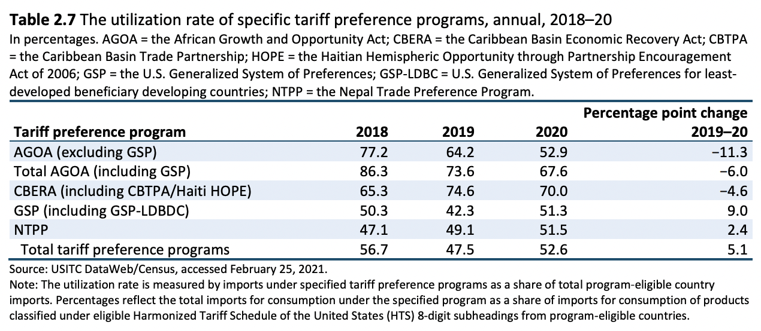
Source: USITC “The Year in Trade 2020”
Notes:
Jones, Lin, et al., “The Year in Trade 2020,” USITC, September 2021.
https://www.usitc.gov/publications/332/pub5228.pdf

Slide 42
Pause for Discussion

Slide 43
  Questions on Verrill
Who has "standing" under the antidumping law? Who determines whether there is dumping?
How do the injury requirements differ for antidumping and for safeguards? Do either require that the domestic firms make losses?
What can a U.S. producer do if it believes that its competitors in another country are engaging in anticompetitive conduct that is being tolerated by their government?

Slide 44
  Questions on Jackson
Why did Fast Track, or something like it, become necessary only after trade negotiations were moving on from tariffs to negotiating non-tariff measures?
Once a trade agreement is negotiated and accepted, does it automatically become part of the law of the participating countries?
What are the four requirements of the Fast Track procedure that was first approved by Congress? Under what President was this done?

Slide 45
  Questions on Turton,
  “… Asia manufacturers sweat”
What is GSP? Whom does it benefit?
When US GSP it expire?
How is it proposed to change?
Is this a partisan issue?
Seems like a simple bill. Is it?

Slide 46
US Trade Policies under Biden
He’s done very little, so far. Mostly waiting to study issues
  Negotiated with EU and others on steel and aluminum tariffs, and replaced with tariff-rate quotas
  Settled the Airbus-Boeing dispute
  Nuclear submarine exports to Australia

Slide 47
US Trade Policies under Biden
USTR said (last year) Biden wants trading system that
  “is fair”
  “promotes inclusive economic growth”
  “reflects America’s universal values”
  “respects the dignity of work”
  “values Americans as workers and wage-earners, not only as consumers”

Slide 48
US Trade Policies under Biden
Restore U.S. global leadership on critical matters like
  combatting forced labor
  exploitative labor conditions
  corruption,
  discrimination against women and minorities

Slide 49
US Trade Policies under Biden
Wants trade policies to
  address the climate crisis
  bolster sustainable renewable energy supply chains
  end unfair trade practices
  discourage regulatory arbitrage
  foster innovation and creativity

Slide 50
US Trade Policies under Biden
Address China’s Coercive and Unfair Economic Trade Practices through a comprehensive strategy
  more systematic approach than the recent piecemeal approach
  comprehensive review of policy toward China
  address China’s “detrimental actions”
  address the widespread human rights abuses
  strengthen enforcement

Slide 51
US Trade Policies under Biden
China’s “detrimental actions.” List includes:
    China’s tariffs and non-tariff barriers,
    government-sanctioned forced labor programs,
    overcapacity in numerous sectors,
    industrial policies utilizing unfair subsidies,
    export subsidies,
    technology transfers,
    illicit acquisition and infringement of American intellectual property,
    censorship and other restrictions on the internet and digital economy.

Slide 52
Pause for Discussion

Slide 53
  Questions on USTR “Agenda”
What are some of the most important aspects of trade policy for Biden?
What does this seem to say about trade based on comparative advantage?
What should “new trade rules” support?
What has the Biden Administration negotiated with other countries that this brags about?

